Slide 1
WORLD OF DRONE
Drone Application: Search and Rescue

Slide 2
?
Drone Application: Search and Rescue
UAVs were used in search and rescue after hurricanes struck Louisiana and Texas in 2008.

Slide 3
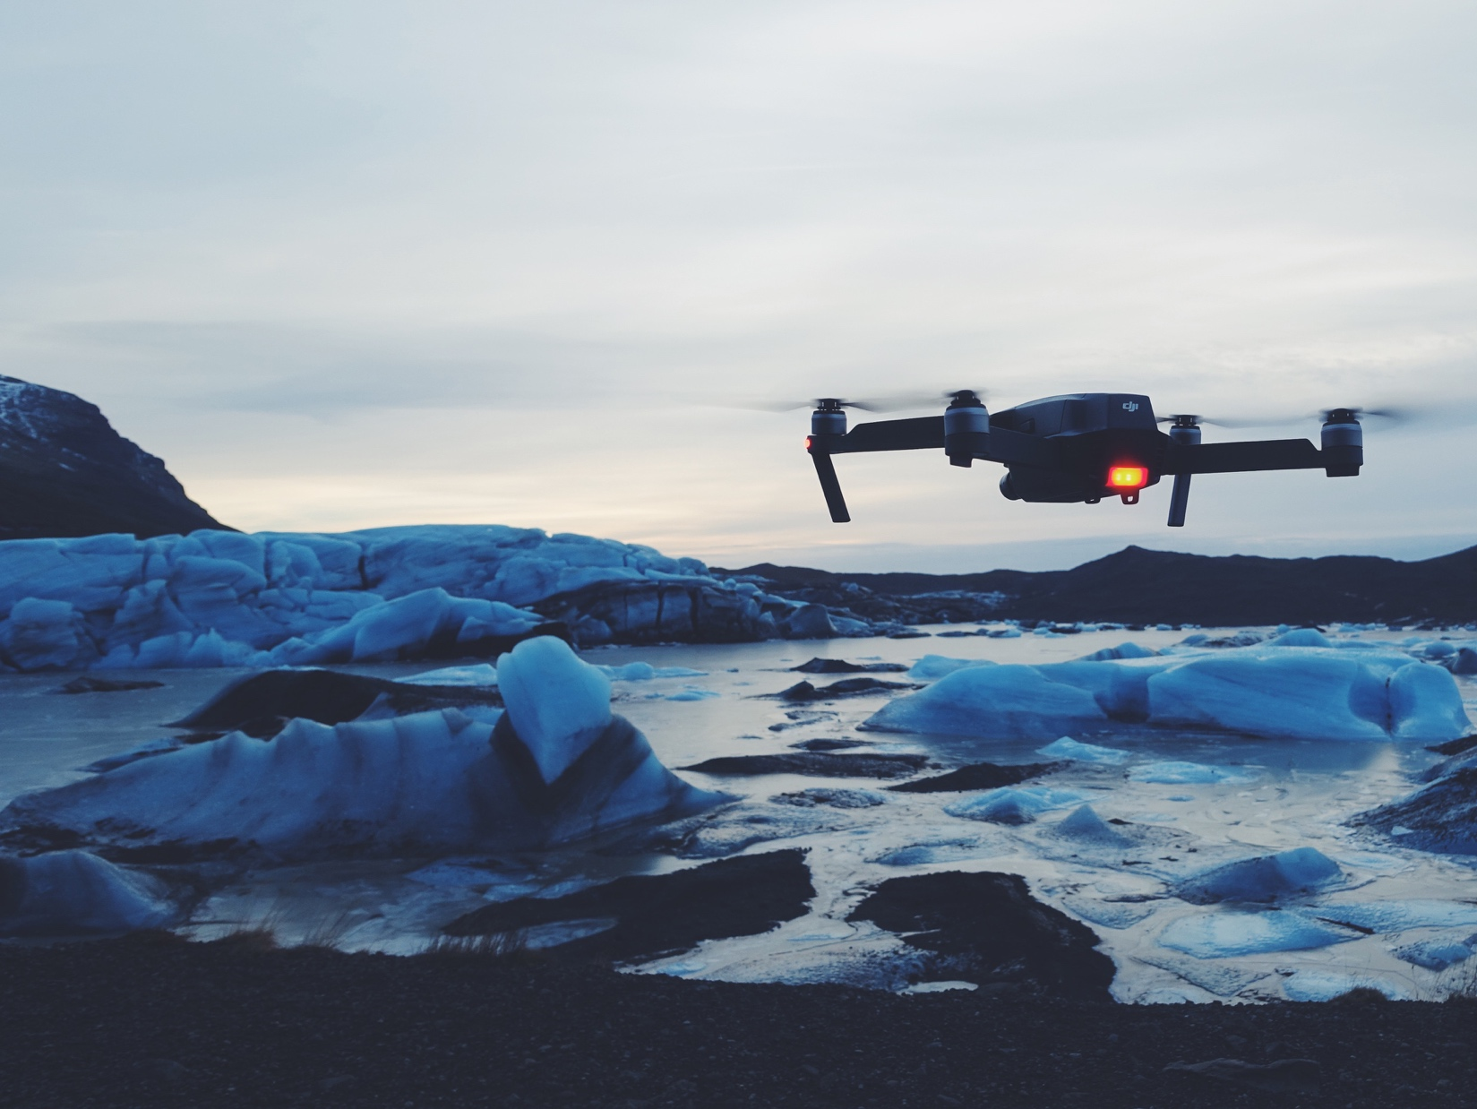
Drone Application:
Search and Rescue
Photos taken before and after the storm are compared and a computer highlights damage areas.

Slide 4
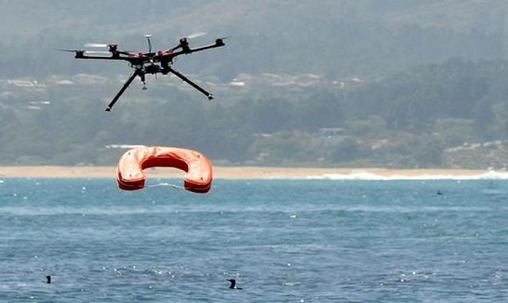
?
Drone Application: Search and Rescue
UAVs have been tested as airborne lifeguards, locating swimmers in danger using thermal cameras and dropping life preservers to swimmers.

